Slide 1


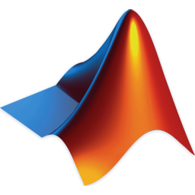
Matrix Laboratory Data Processing
Assignments 1 & 2
Course: Computer Programming Group 7
Busitema University
Date: 23 Sept 2025

Slide 2
Declaration & Group Members
We declare that this information in this report is our own, to the best of our knowledge.
Name | Course | Reg. No.
Kakuru Obadiah | WAR | BU/UP/2024/1029
Ssebakiijje Hosea | AMI | BU/UP/2024/0847
Sembera Sherina Tapiness | MEB | BU/UP/2024/5349
Adipo Hope Odware | MEB | BU/UP/2024/0980
Kobusingye Bethline | PTI | BU/UG/2024/2602
Nyero Maria Asumpta | WAR | BU/UP/2024/2602
Gudoi Allan | WAR | BU/UP/2024/4449
Etyang Jonathan | APE | BU/UG/2024/2671
Esarait Brian | MEB | BU/UP/2024/5343
[13]

Slide 3
Introduction
MATLAB is a high‑performance language for technical computing and is built around the concept of matrices. Developed in the late 1970s by Cleve Moler, it enables fast linear algebra, visualisation, and integration with other languages. In this project, we retrieved an economic dataset from Kaggle and used MATLAB to process the data, organise it by year, convert tables into structures, and export results to Excel. We then created a variety of plots to visualise patterns and captured our group’s attributes in structured variables.
[2]

Slide 4
Study Methodology
• Each member researched the assignment before the first meeting. • We watched tutorials on YouTube and consulted continuing students for guidance. • We divided tasks to efficiently retrieve, process and visualise data using MATLAB. • Collaboration and consistent meetings ensured progress on each requirement.
[17]

Slide 5
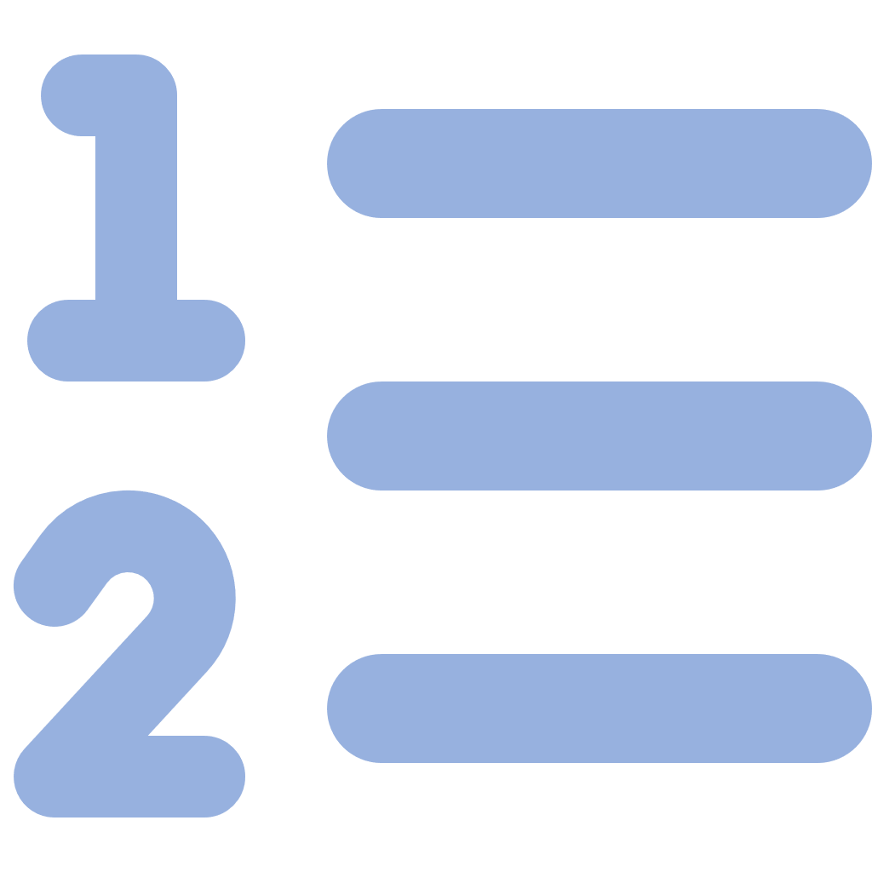
Agenda
Data Retrieval & Processing
Separating & Structuring Data
Exporting to Excel
Data Visualization Overview
Member Attributes & Visualisation
Conclusion
[1]

Slide 6

Data Retrieval & Processing
Download Dataset Login to Kaggle.com and download the economic performance dataset.
View Data Display MS to verify that columns like year, country_name, unemployment and GDP are loaded.
Load into MATLAB Use readtable() to import the Excel file into a table variable (MS).
[3]

Slide 7
THE WORKFLOW OF THE TASK WE PERFORMED
We had a multi-step data processing task to implement in MATLAB.
Source: Download a unique dataset from Kaggle.com in Excel format.
Import: Read the dataset into the MATLAB environment.
Process:
Create annual tables.
Convert tables to structural arrays.
Export: Generate a new Excel workbook with organized, labeled sheets.
This workflow ensures data is structured, accessible, and reusable for analysis.

Slide 8
Assignment 1: Data Retrieval
Step 1: Open Kaggle.com and select a dataset. Step 2: Sign in, download the Excel dataset and save it locally. Step 3: Copy the file path and open a new script in MATLAB. Step 4: Save the script in the working directory and read the data table:
[18]

Slide 9
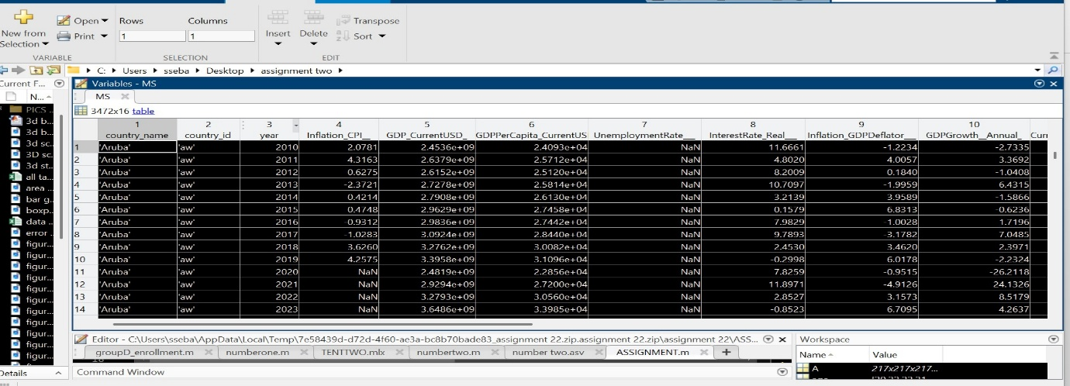
MS = readtable("C:\Users\sseba\Desktop\assignment two\data set assignment one.xlsx");
disp(MS)
readtable(): Reads Excel data into MATLAB table format
disp(MS): Displays table contents for verification
Data Structure: Contains country economic data with columns like year, country_name, UnemploymentRate, GDP, etc

Slide 10

Separating & Structuring
Filter the master table by year to create tables MS2010–MS2025
MS2010 = MS(MS.year==2010, : );
MS2011 = MS(MS.year==2011, : );
% ... continues through 2025
Logic: Filters main table MS by year condition
MS.year==2010: Creates logical index for rows where year equals 2010
Result: 16 separate tables (2010-2025), each containing data for that specific year
MS 2010 is the variable name for the specific year
[4]

Slide 11
Use table2struct() to convert each table into a structure array (S2010–S2025).
table2struct(): Converts table to structure array
Tables: Column-based, ideal for spreadsheet-like data
Structures: Field-based, better for object-oriented data
%conversion of tables into struts
S2010=table2struct(MS2010);%for MS2010
S2011=table2struct(MS2011);%for MS2011

Slide 12

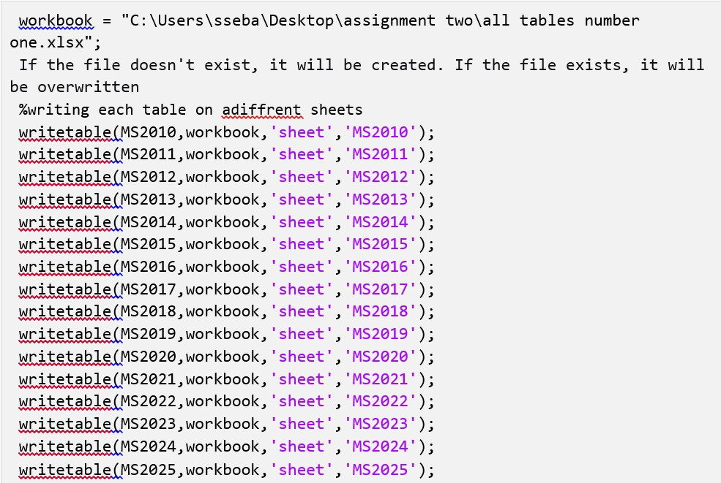
Exporting to Excel
Define a workbook filename with path.
Use writetable() to write each table (2010–2025) to its own sheet.
Sheets are named after years for easy navigation.
[5]

Slide 13
Data Visualisation Overview
Using MATLAB’s plotting functions, we explored a variety of graphs to discover patterns in economic data.
We used bar and scatter plots to compare unemployment, inflation, GDP and other indicators across years and countries. Pareto and histograms illustrated distribution patterns, while box and pie charts depicted spread and proportions. Mesh and surface plots, heat maps, quiver and 3D stems provided 3‑dimensional insights into multidimensional relationships.
[6]

Slide 14
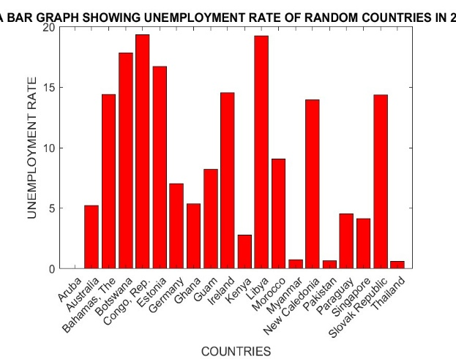
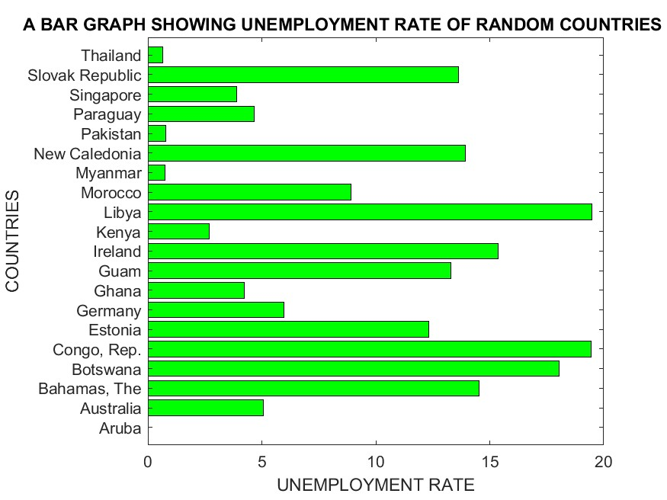
Assignment 2: Bar Graphs
We plotted bar graphs of unemployment rates for 2010 and 2011. • 2010: vertical bar graph of selected countries. • 2011: horizontal bar graph showing unemployment rates.
[21]

Slide 15
CODE
%UNEMPLOYMENT RATE 2010
figure;
Countrynames2010=MS2010.country_name(1:10:200);
Unemployment2010=MS2010.UnemploymentRate___(1:10:200);
bar(categorical(Countrynames2010),Unemployment2010,'r');
xlabel('COUNTRIES');
ylabel('UNEMPLOYMENT RATE');
title('A BAR GRAPH SHOWING UNEMPLOYMENT RATE OF RANDOM COUNTRIES IN 2010')
%UNEMPLOYMENT RATE 2011
figure;
Countrynames2011=MS2011.country_name(1:10:200);
Unemployment2011=MS2011.UnemploymentRate___(1:10:200);
barh(categorical(Countrynames2011),Unemployment2011,'g');
ylabel('COUNTRIES');
xlabel('UNEMPLOYMENT RATE');
title('A BAR GRAPH SHOWING UNEMPLOYMENT RATE OF RANDOM COUNTRIES IN 2011'),
%2012 inflation cpl against gdp current

Slide 16
Scatter plot Inflation vs GDP
%2012 inflation cpl against gdp current
figure;
T=table(MS2012.country_name(1:10:200),MS2012.Inflation_CPI__(1:10:200),MS2012.GDP_CurrentUSD_(1:10:200),'VariableNames',{'countrynames','inflation','GDP_Current'});
The code creates a table having country names, inflation_CPI_and GDP CURRENT of year 2012,picking the 10th countries from 1 to 200
scatter(T.inflation,T.GDP_Current,'k*');
xlabel('INFLATION 2012');
ylabel('GDP CURRENT 2012');
title('A SCATTER GRAPH OF INFLATION AGAINST GDP 2012');
ylim([-1e12,4e12]);
The code Examines correlation between inflation and GDP
'k*': Black asterisk markers
ylim(): Sets y-axis limits from -1 trillion to 4 trillion USD

Slide 17
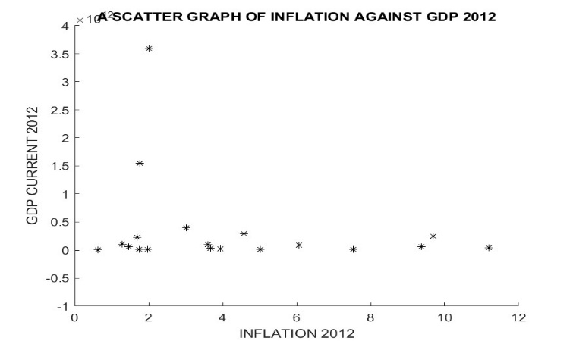

Slide 18
PARETO
T2013=table(MS2013.country_name(17:24),MS2013.GovernmentExpense__OfGDP_(17:24),'VariableNames',{'countrynames','governmentexp'});
The code creates a table with country name and government expense
T2013sorted=sortrows(T2013,'governmentexp','descend');
figure;
pareto(T2013sorted.governmentexp,T2013sorted.countrynames);
xlabel('COUNTRIES');
ylabel('GOVERNMENT EXPENDIURE');
title('A PARETO CHART SOWING GOVT EXPENDITURE IN 2013 FOR SELECTED COUNTRIES')

Slide 19
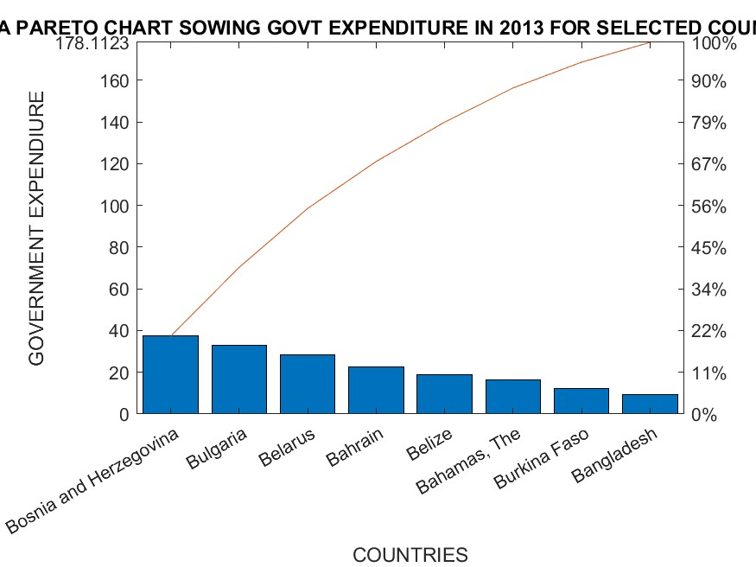

Slide 20
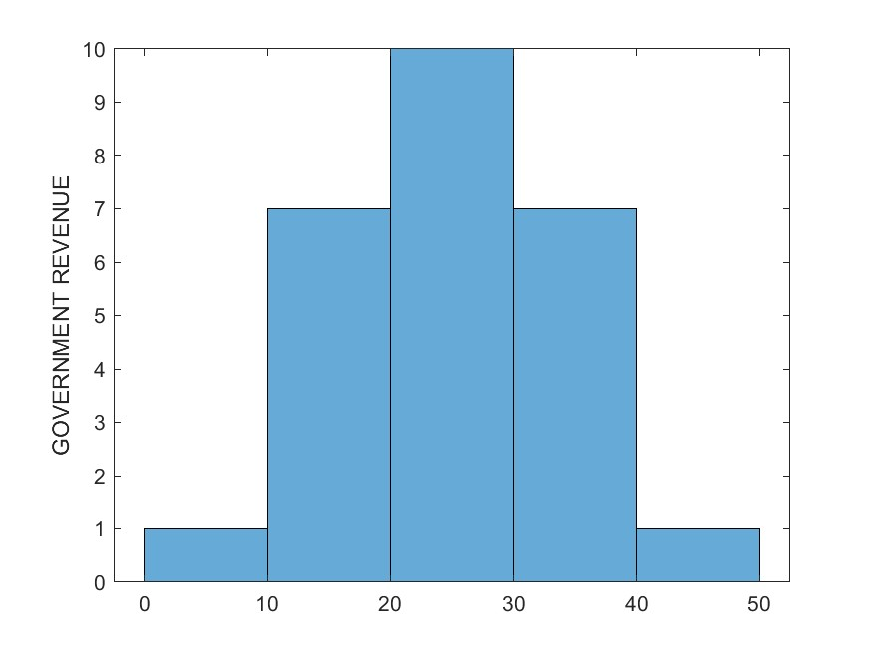
HISTOGRAM
T2014=table(MS2014.country_name(1:5:200),MS2014.GovernmentRevenue__OfGDP_(1:5:200),'VariableNames',{'countrynames','government_revenue'});
figure;
histogram(T2014.government_revenue);
ylabel('GOVERNMENT REVENUE');

Slide 21
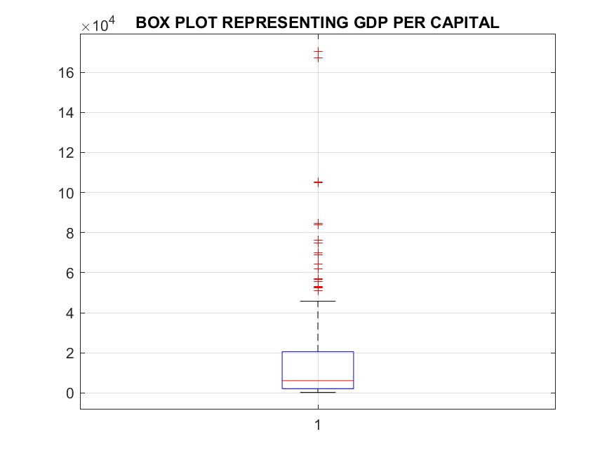
Box plot
%2015 GDP
figure;
boxplot(MS2015.GDPPerCapita_CurrentUSD_);
grid on;
title('BOX PLOT REPRESENTING GDP PER CAPITAL');

Slide 22
PIE CHART
%2016 PIECHART
T2016=table(MS2016.country_name(1:10:200),MS2016.UnemploymentRate___(1:10:200),'VariableNames',{'countrynames','UnemploymentRate'});
Finite_idx=isfinite(T2016.UnemploymentRate);
fincountry=T2016.countrynames(Finite_idx);
finemp=T2016.UnemploymentRate(Finite_idx);
figure;
pie(finemp,fincountry);
title('A PIE CHART SHOWING UNEMPLOYMENT RATE OF 2016');
legend;

Slide 23
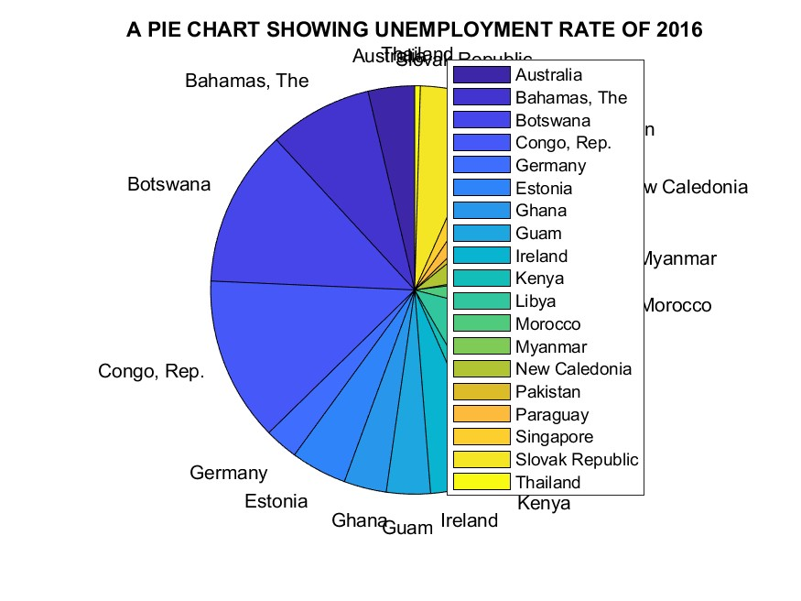

Slide 24
MESH GRID
%2017 CATEGORIZATION
T2017=table(MS2017.country_name(1:10:200),MS2017.UnemploymentRate___(1:10:200),MS2017.GovernmentExpense__OfGDP_(1:10:200),'VariableNames',{'countrynames','UnemploymentRate','Governmentexp'});
[X, Y]=meshgrid(T2017.UnemploymentRate,T2017.Governmentexp);
figure;
Z=X.^2+Y.^2;
surf(X,Y,Z);
xlabel('UNEMPLOYMENT RATE');
ylabel('GOVERNMENT EXPENDITURE');
title('RELATIONSHIP OF THE SQUARES OF UNEMPLOYMENT RATE AND GOVERNMENT EXPENDITURE');
meshgrid(): Creates 2D grid from 1D vectors
Z=X.^2+Y.^2: Calculates squared distance function
surf(): 3D colored surface plot

Slide 25
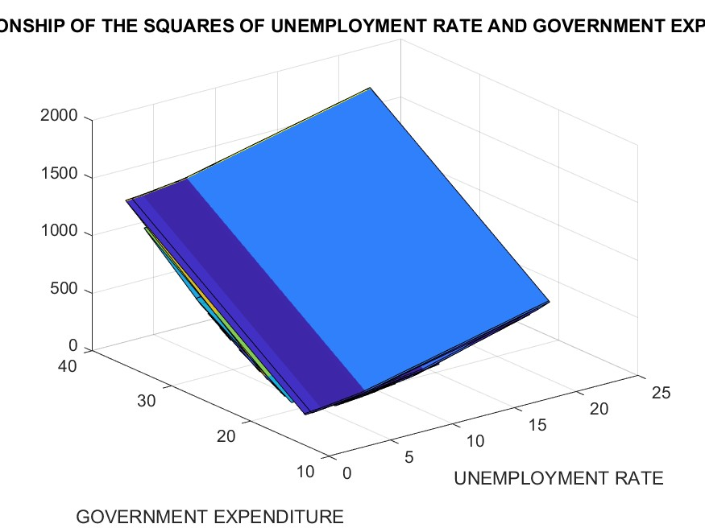

Slide 26
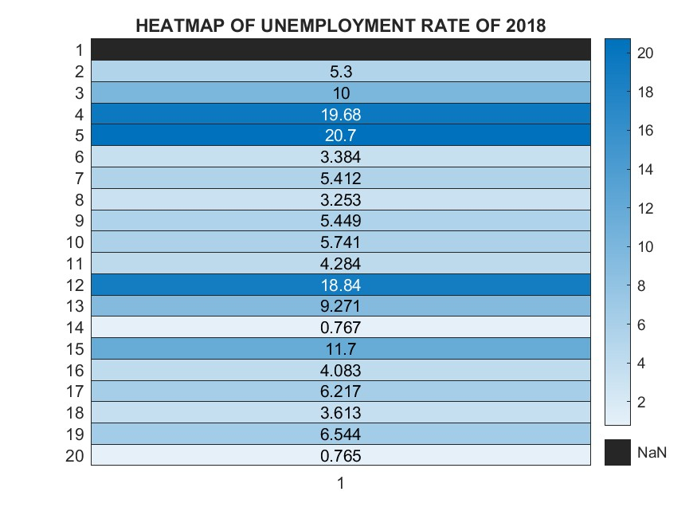
HEAT MAP
figure;
heatmap(MS2018.UnemploymentRate___(1:10:200));
title('HEATMAP OF UNEMPLOYMENT RATE OF 2018');
The code creates a heatmap using unemployment rate

Slide 27
MESH GRID
%2017 CATEGORIZATION
T2017=table(MS2017.country_name(1:10:200),MS2017.UnemploymentRate___(1:10:200),MS2017.GovernmentExpense__OfGDP_(1:10:200),'VariableNames',{'countrynames','UnemploymentRate','Governmentexp'});
[X, Y]=meshgrid(T2017.UnemploymentRate,T2017.Governmentexp);
figure;
Z=X.^2+Y.^2;
surfc(X,Y,Z);
xlabel('UNEMPLOYMENT RATE');
ylabel('GOVERNMENT EXPENDITURE');
title('RELATIONSHIP OF THE SQUARES OF UNEMPLOYMENT RATE AND GOVERNMENT EXPENDITURE');

Slide 28
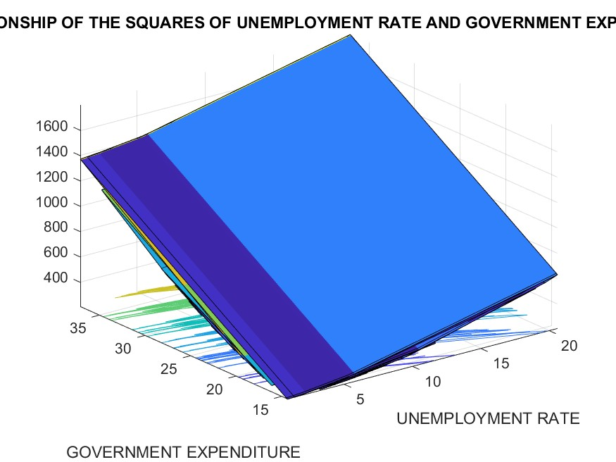

Slide 29
QUIVER PLOT
%2018 unemployment
figure;
M=MS2018.UnemploymentRate___;
[A B C]=meshgrid(M);
u=sin(A);
v=sin(B);
w=C;
quiver3(A,B,C,u,v,w,'r');
title('3D QUIVER PLOT');

Slide 30
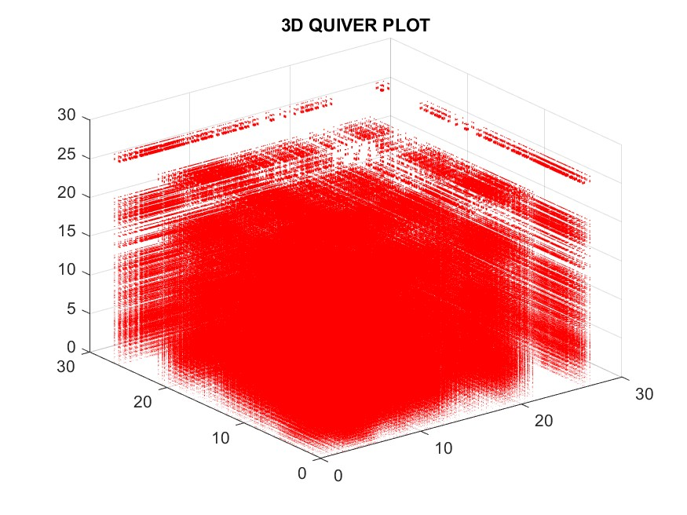

Slide 31

Visual Insights
2010 vs 2011: Unemployment patterns differ markedly between countries.
Inflation vs GDP (2012): Higher inflation often coincided with larger GDP values.
Government spending and revenue showed skewed distributions across years.
Advanced 3D plots revealed nonlinear relationships between unemployment, government expenditure and other metrics.
[7]

Slide 32

Conclusion
Our group successfully used MATLAB to perform end‑to‑end data processing: • Retrieved a real‑world dataset from Kaggle and loaded it into MATLAB. • Organised data by year and transformed tables into structured arrays. • Exported organised data into a multi‑sheet Excel workbook. • Visualised complex patterns via numerous 2D and 3D plots. • Captured and explored our own attributes through structured coding and charts.
Teamwork, division of tasks and creative exploration were key to completing these assignments.
Thank you!
[11] [12]

Slide 33

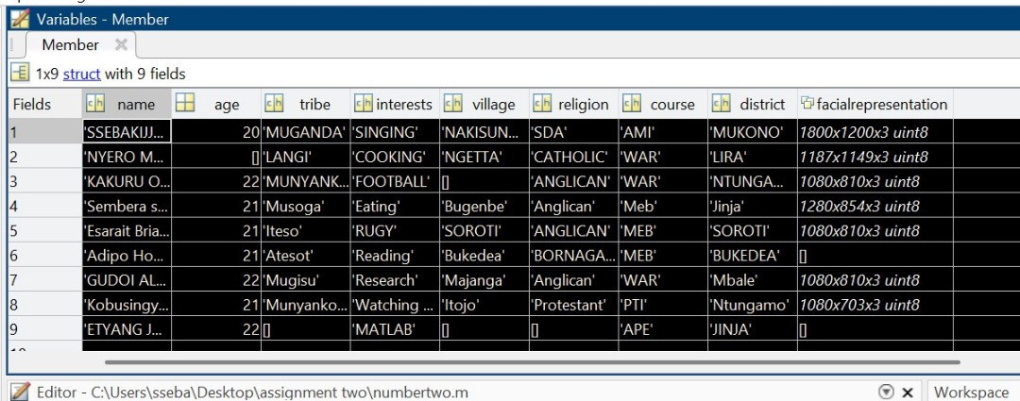
Member Attributes Structure
We captured each member’s name, age, tribe, interests, village, religion, course, district and photo in a single structured variable using MATLAB.
% defining struct
Members=struct('name',{},'age',{},'tribe',{},'interests',{},'village',{},'religion',{},'course',{},'district',{},'facialrepresentation',{});
Structured variable:
Members(name, age, tribe, ...)
[8] [9]

Slide 34
Member Attribute Visualisations
We generated numerous plots of member attributes: • Bar and stair plots to show age relations. • Scatter, line, stem and step plots to explore trigonometric functions of age. • 3D surfaces and scatter plots to visualise sin and cos transformations in three dimensions. • Pie, box, area and Pareto charts to summarise distribution and spread.
[10]

Slide 35
Member Attributes Code (1/4)
Define the struct and add details for members 1–2.
% defining struct
Members=struct('name',{},'age',{},'tribe',{},'interests',{},'village',{},'religion',{},'course',{},'district',{},'facialrepresentation',{});
%Member 1
Member(1).name='SSEBAKIJJE HOSEA';
Member(1).age=21;
Member(1).tribe='MUGANDA';
Member(1).interests='SINGING';
Member(1).village='NAKISUNGA';
Member(1).religion='SDA';
Member(1).course='AMI';
Member(1).district='MUKONO';
Member(1).facialrepresentation='C:\\\Users\\sseba\\Desktop\\assignment two\\PICS GROUP 7\\DSC_6414.JPG';
%Member 2
Member(2).name = 'NYERO MARIA';
member(2).age=22;
Member(2).tribe = 'LANGI';
Member(2).interests = 'COOKING';
Member(2).village = 'NGETTA';
Member(2).religion = 'CATHOLIC';
Member(2).course = 'WAR';
Member(2).district = 'LIRA';
Member(2).facialrepresentation = 'C:\\\Users\\sseba\\Desktop\\assignment two\\PICS GROUP 7\\maria.jpg';
[26] [27]

Slide 36
Member Attributes Code (2/4)
Continue with members 3–4.
%member 3
Member(3).name = 'KAKURU OBADIAH';
Member(3).age = 22;
Member(3).tribe = 'MUNYANKOLE';
Member(3).interests = 'FOOTBALL';
Member(3).religion = 'ANGLICAN';
Member(3).course = 'WAR';
Member(3).district = 'NTUNGAMO';
Member(3).facialrepresentation = 'C:\\\Users\\sseba\\Desktop\\assignment two\\PICS GROUP 7\\OBADIA.jpg';
% Member4
Member(4).name = 'Sembera sherina Tapiness';
Member(4).age = 21;
Member(4).tribe = 'Musoga';
Member(4).interests = 'Eating';
Member(4).village = 'Bugenbe';
Member(4).religion = 'Anglican';
Member(4).course = 'Meb';
Member(4).district = 'Jinja';
Member(4).facialrepresentation = 'C:\\\Users\\sseba\\Desktop\\assignment two\\PICS GROUP 7\\SHERINA.jpg';
[28] [29]

Slide 37
Member Attributes Code (3/4)
Populate members 5–7.
%Member 5
Member(5).name = 'Esarait Brian';
Member(5).age = 21;
Member(5).tribe = 'Iteso';
Member(5).interests = 'RUGY';
Member(5).village = 'SOROTI';
Member(5).religion = 'ANGLICAN';
Member(5).course = 'MEB';
Member(5).district = 'SOROTI';
Member(5).facialrepresentation = 'C:\\\Users\\sseba\\Desktop\\assignment two\\PICS GROUP 7\\ESIRIAT.jpg';
% Member 6
Member(6).name = 'Adipo Hope Odware';
Member(6).age = 21;
Member(6).tribe = 'Atesot';
Member(6).interests = 'Reading';
Member(6).village = 'Bukedea';
Member(6).religion = 'BORNAGAIN';
Member(6).course = 'MEB';
Member(6).district = 'BUKEDEA';
% Member 7
Member(7).name = 'GUDOI ALLAN';
Member(7).age = 22;
Member(7).tribe = 'Mugisu';
Member(7).interests = 'Research';
Member(7).village = 'Majanga';
Member(7).religion = 'Anglican';
Member(7).course = 'WAR';
Member(7).district = 'Mbale';
Member(7).facialrepresentation = 'C:\\\Users\\sseba\\Desktop\\assignment two\\PICS GROUP 7\\GUDOI.jpg';
[30]

Slide 38
Member Attributes Code (4/4)
Populate members 8–9.
% Member 8
Member(8).name = 'Kobusingye Bethline';
Member(8).course = 'PTI';
Member(8).district = 'Ntungamo';
Member(8).village = 'Itojo';
Member(8).tribe = 'Munyankore';
Member(8).religion = 'Protestant';
Member(8).age = 21;
Member(8).interests = 'Watching movies';
Member(8).facialrepresentation = 'C:\\\Users\\sseba\\Desktop\\assignment two\\PICS GROUP 7\\bethelene.jpg';
%Member 9
Member(9).name = 'ETYANG JONATHAN';
Member(9).age = 22;
Member(9).interests = 'MATLAB';
Member(9).district = 'JINJA';
Member(9).course = 'APE';
[31] [32]

Slide 39
Members Visualisation (Part 1)
This code visualises ages with various 2D plots: bar, stair, horizontal bar, scatter, line, stem, step, error bar, area and histogram.
%% Assignment 2
figure("Name","RELATION OF AGE AND NAMES")
age = [20 22 22 21 21 21 22 21 22];
Names = categorical({'SSEBAKIJJE HOSEA','NYERO MARIA','KAKURU OBADIAH','Sembera sherina Tapiness','Esarait Brian','Adipo Hope Odware','GUDOI ALLAN','Kobusingye Bethline','ETYANG JONATHAN'});
bar(Names,age)
xlabel('names');
ylabel('age');
title('RELATION OF AGE AND NAMES');
grid on
%stair plot of cos(age) aganist ages
figure("Name","stair plot of cos(age)aganist ages" )
c = cos(age);
s = sin(age);
stairs(age,c)
xlabel('age');
ylabel('c');
grid on;
title('cos(age) aganist age');
% horizontal bar graph
figure("Name","HORIZONTAL BAR GRAPH)")
barh(Names,age);
xlabel('AGE');
ylabel('NAME');
title('HORIZONTAL GRAPH')
grid on
[30]

Slide 40
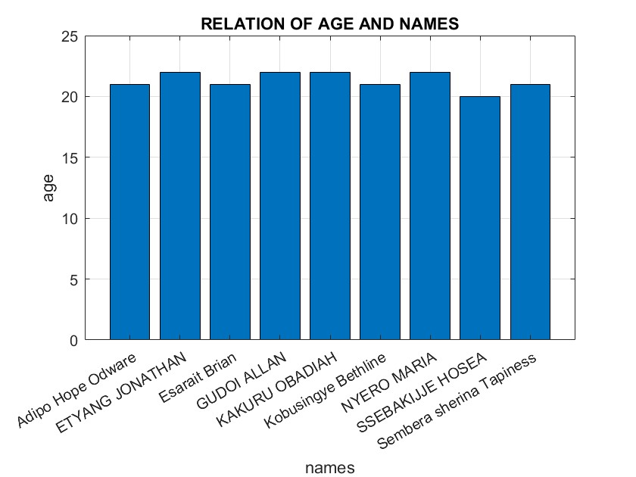
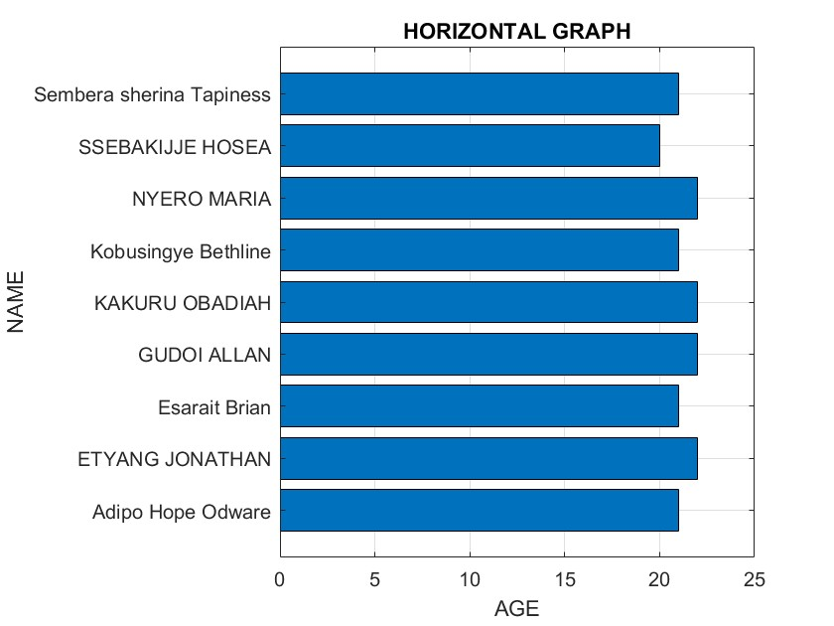
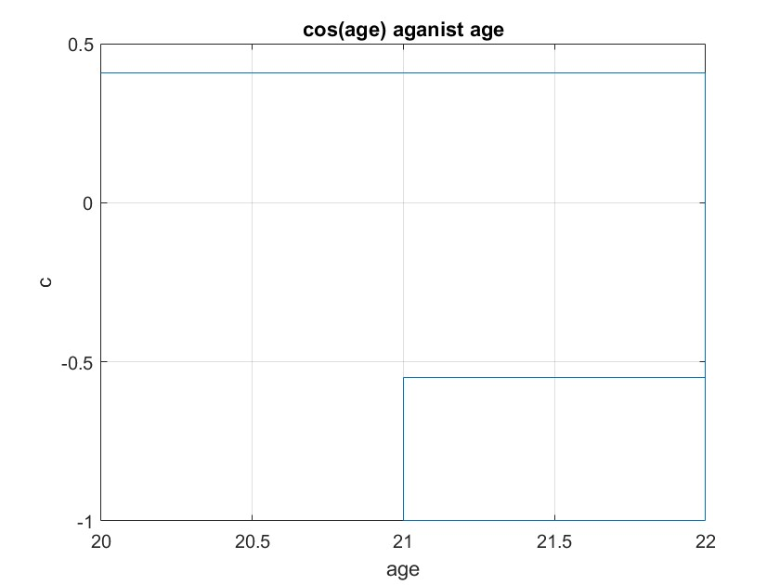

Slide 41
%scatter graph of age and sin(age)
figure("Name","scatter graph");
scatter(age,s);
xlabel('AGE');
ylabel('sin(age)')
title('scatter graph')
grid on
%line plot
figure('Name','line plot');
plot(c,s,'r')
xlabel('cos(age)');
ylabel('sin(age)');
title('line plot')

Slide 42
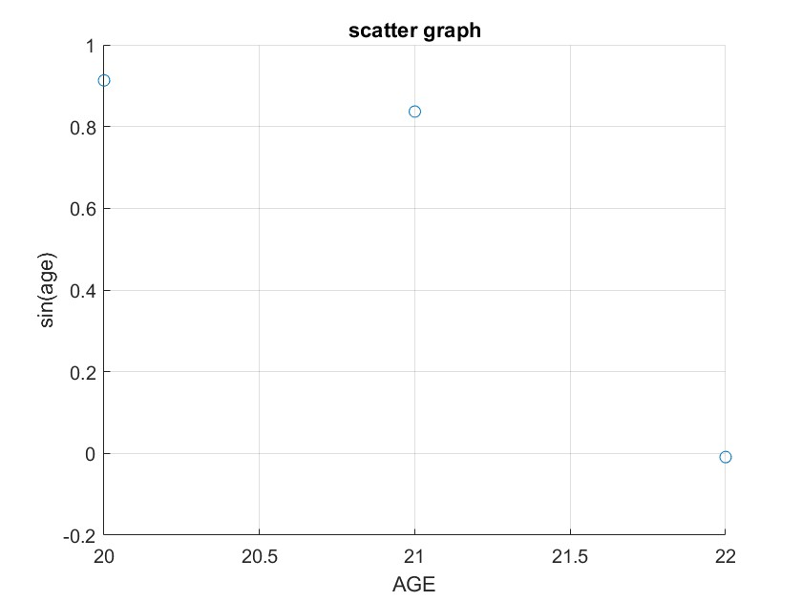
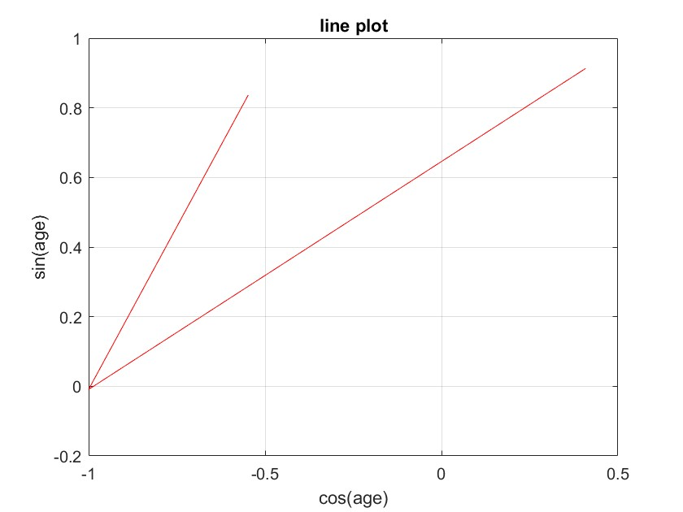

Slide 43
%stem plot
figure('Name','stem plot')
stem(c,s)
xlabel('cos(age)');
ylabel('sin(age)');
title('stem plot of sin(age)and cos(age)')
grid on
%step plot
figure('Name','step plot')
step(c,age)
xlabel('cos(age)');
ylabel('age');
title('step plot of age and cos(age)');
grid on
%error bar plot
figure('Name','error bar plot')
errors = age-4;
errorbar(c,age,errors)
xlabel('cos(age)');
ylabel('age');
title('error bar plot');
grid on

Slide 44
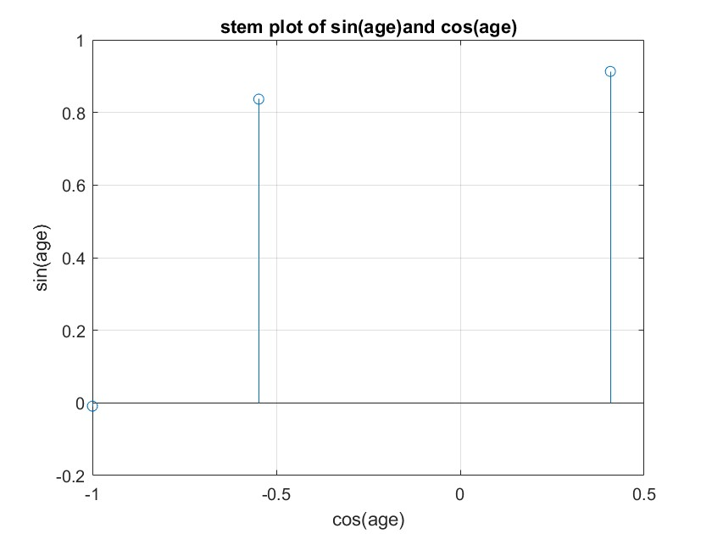
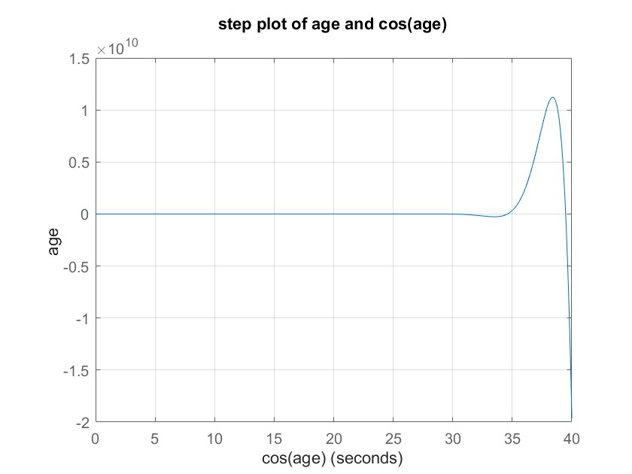
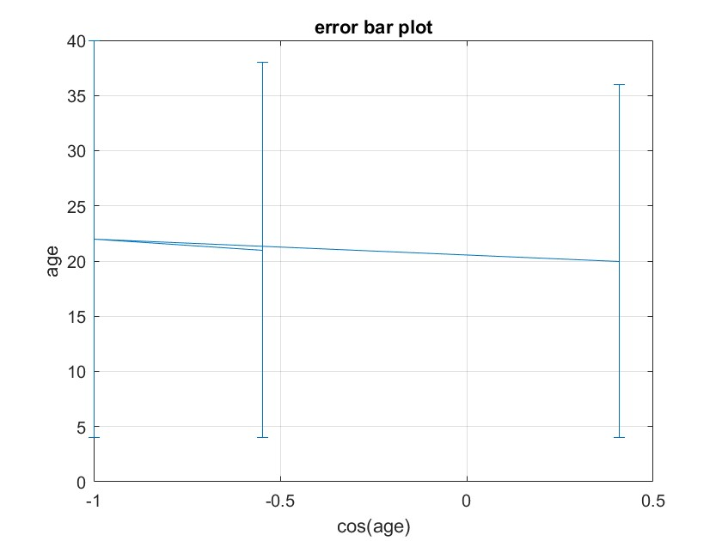

Slide 45
%Area plot
figure('Name','Area plot');
area(errors,age);
xlabel('errors');
ylabel('age');
title('Area plot');
grid on
%Histogram
figure('Name','Histogarm');
histogram(age);
xlabel('AGE');
title('HISTOGRAM OF AGE');
grid on;
%pareto chert
figure('Name','PARETO CHART');
pareto(age);
title('PARETO CHART');

Slide 46
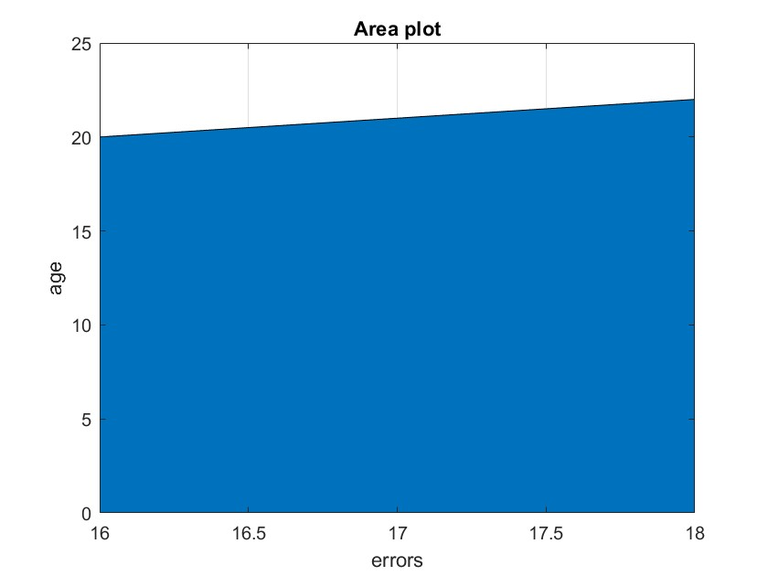
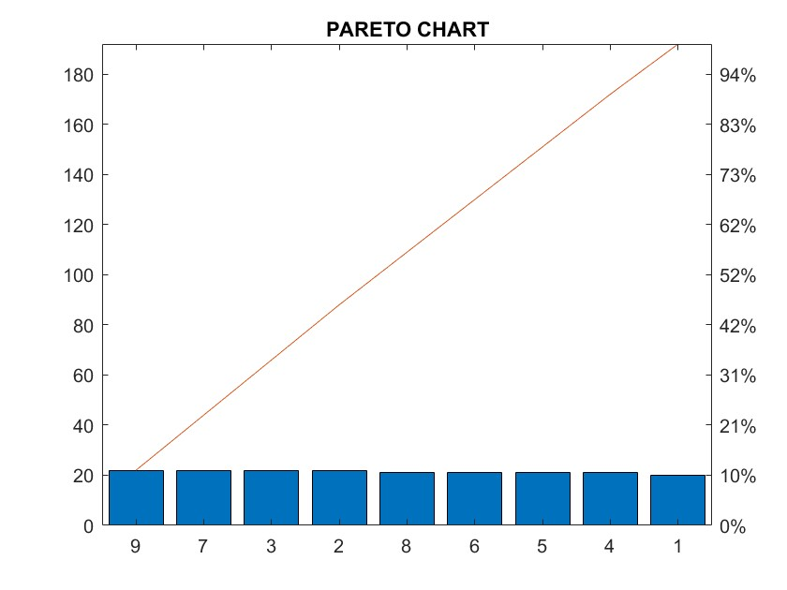
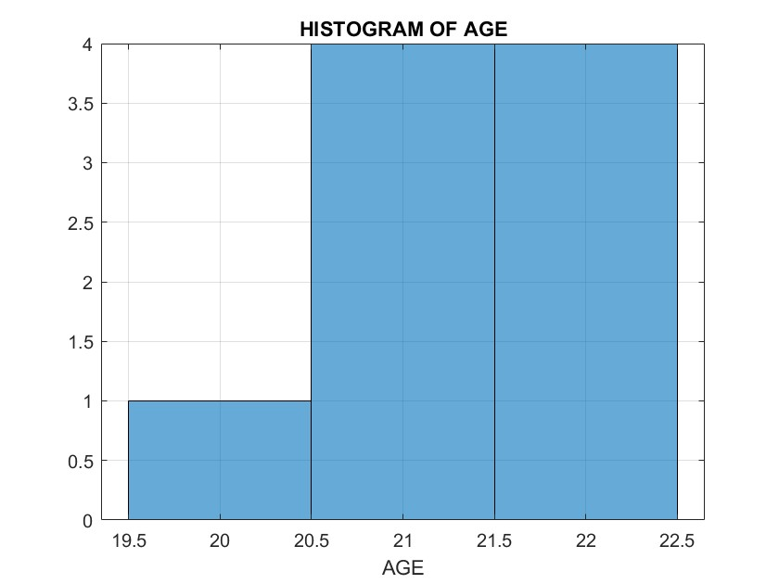

Slide 47
%BOX PLOT
figure('Name','Box plot');
boxplot(age);
title('BOX PLOT');
%pie chart
figure('Name','PIECHART OF AGES');
pie(age);
title('PIECHART OF AGES');
%LOGARITHIMIC PLOT
figure('Name','LOG CURVE');
D = exp(s);
semilogx(age,D);
title('LOG CURVE OF AGE');
grid on
%stem 3 plot
figure('Name','STEM 3 PLOT');
stem3(age,s,c);
title('3D STEM PLOT');

Slide 48
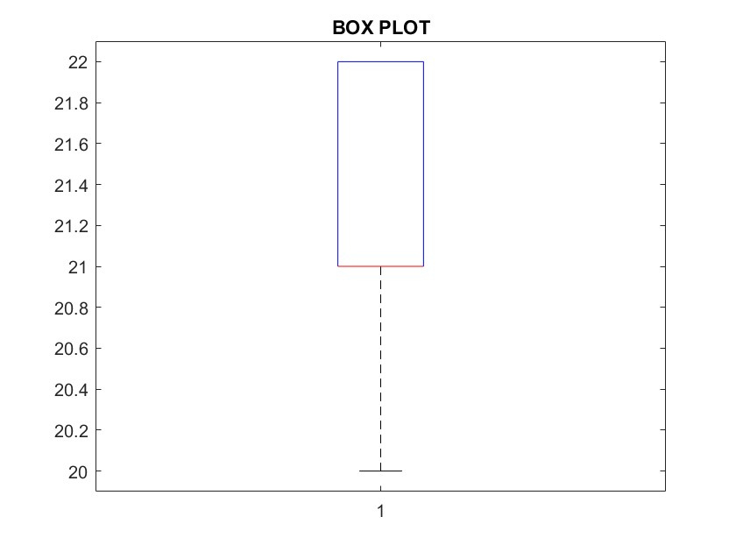
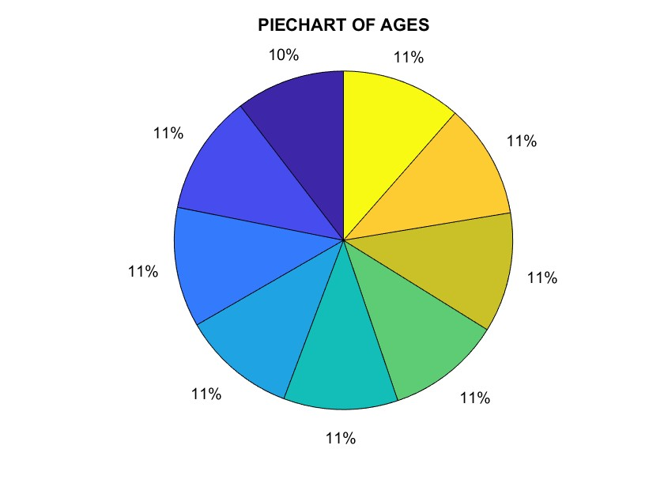
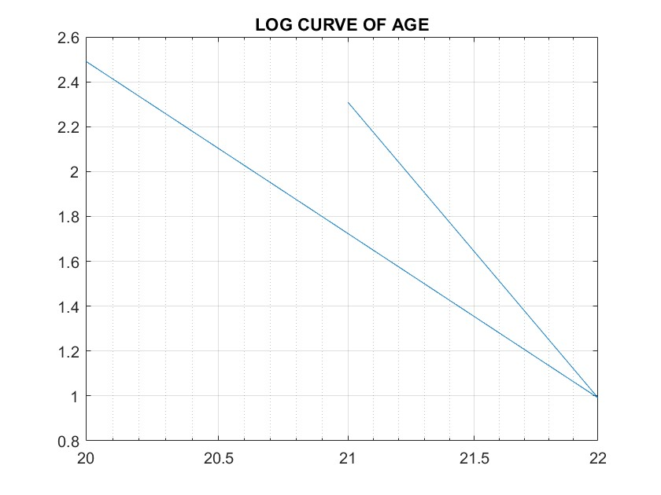

Slide 49
SURFACE PLOT
figure('Name','SURFACE PLOT');
x = 20:0.5:22
[x,y] = meshgrid(x);
z = x.*2+y.*4;
surf(x,y,z);
xlabel('x');
ylabel('y');
zlabel('z');
title('SURFACE PLOT');
%MESH PLOT
figure('Name','meshplot');
h = sin(x)+cos(y);
mesh(x,y,h);
xlabel('x');
ylabel('y');
zlabel('z');
title('MESH PLOT');
%WATER FALL PLOT
figure('Name','WATER FALL PLOT');
waterfall(x,y,z);
xlabel('xvalues');
ylabel('yvalues');
zlabel('zvalues');
title('water fall plot')

Slide 50
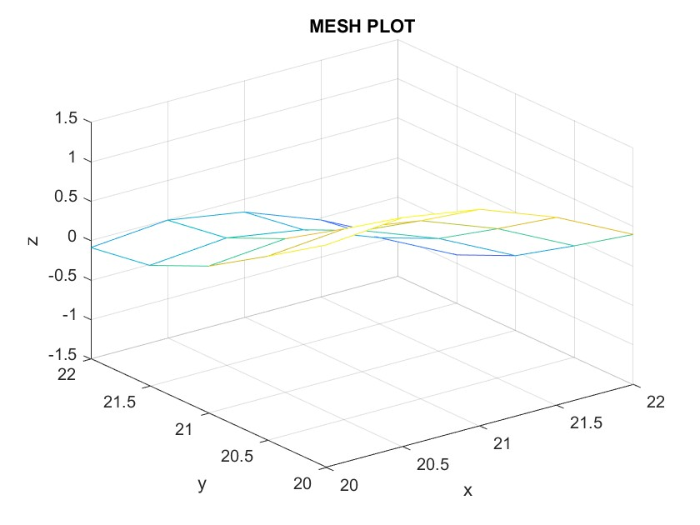
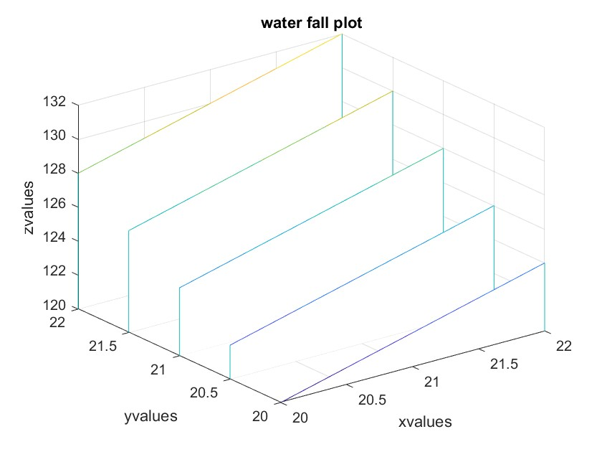

Slide 51
%SCATTER PLOT
figure('Name','SCATTER PLOT');
scatter3(x,y,z);
xlabel('xvalues');
ylabel('yvalues');
zlabel('zvalues');
title('SCATTER PLOT')
%3D BAR
figure('Name','BAR')
bar3(age)
title('D BARGRAPH')
%GEOPLOT
figure('Name','GEOPLOT');
geoplot(age,s)
title('GEOPLOT')

Slide 52
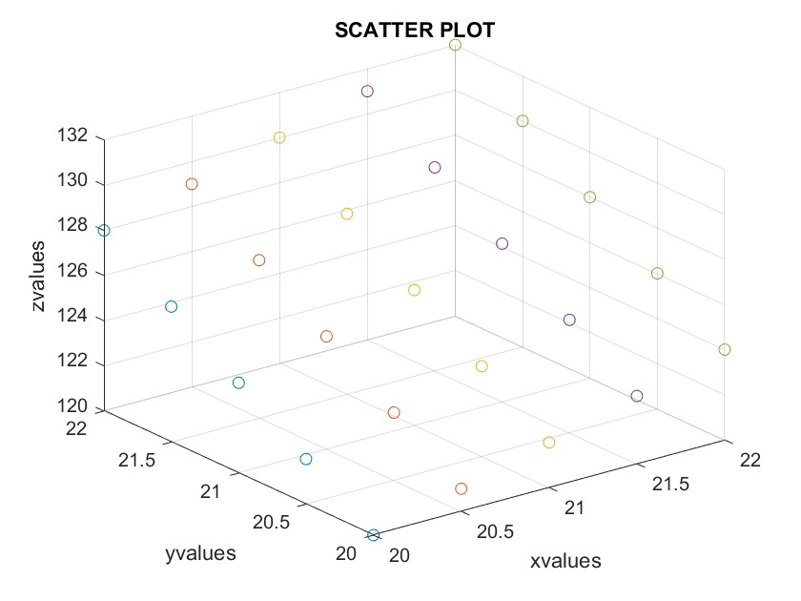
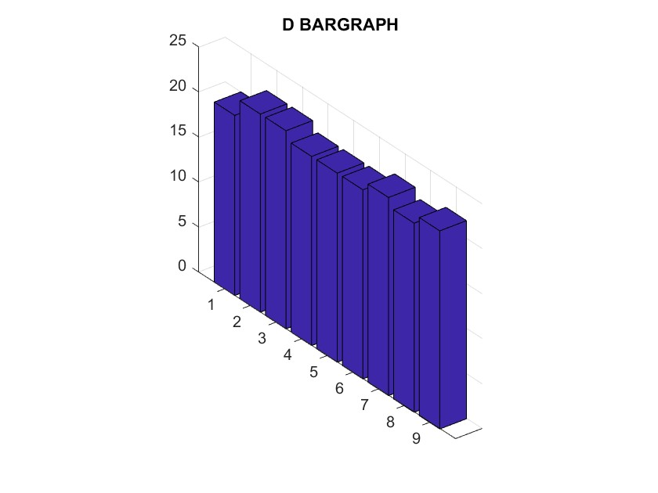
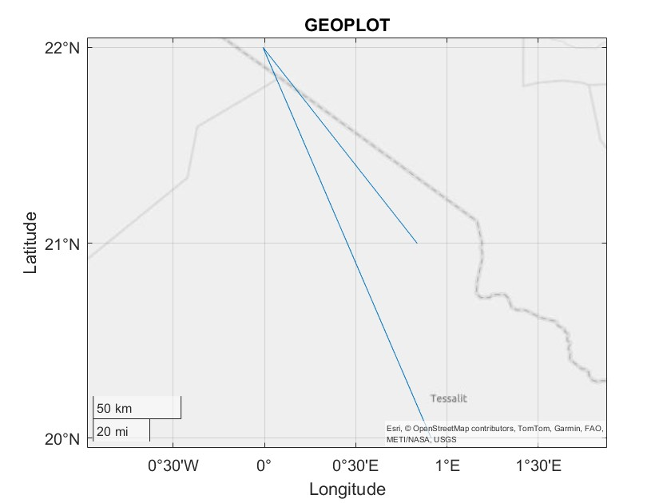

Slide 53
Conclusion & Key Insights
Through these assignments we learned how to retrieve, organise and visualise data using MATLAB. • Successfully retrieved and processed a Kaggle dataset. • Organised data into yearly tables and structures and exported them to a multi‑sheet Excel workbook. • Generated a wide array of 2D and 3D plots to analyse economic indicators and member attributes. • Captured group member details using structs and visualised them with various charts.
Teamwork and creative exploration were essential to our success.
Thank you for your attention!
[34] [35]

